Slide 1


Slide 2




How many teaspoons of sugar is the MAXIMUM daily allowance?
3
6
9
Notes:
The American Heart Association have recommended maximum daily allowances for Children (3), Woman (6) and Men (9).

Slide 3

1.5L
6 5 6 11 18 40

Slide 4
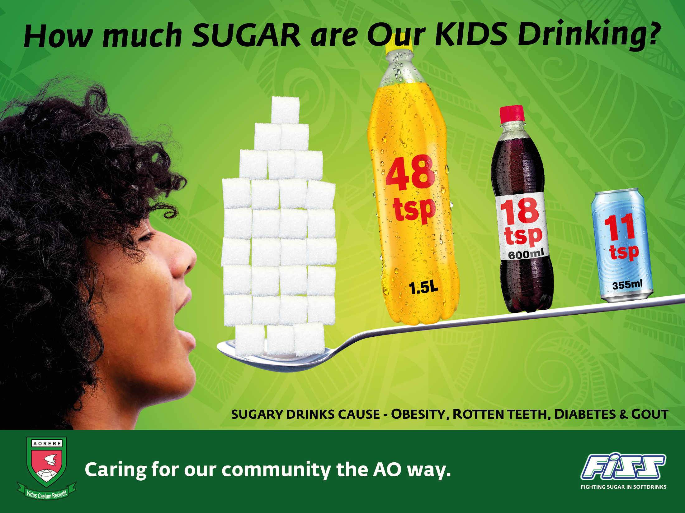

Slide 5
Industry Tricks X 3

Slide 6
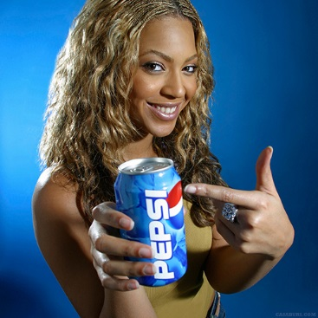
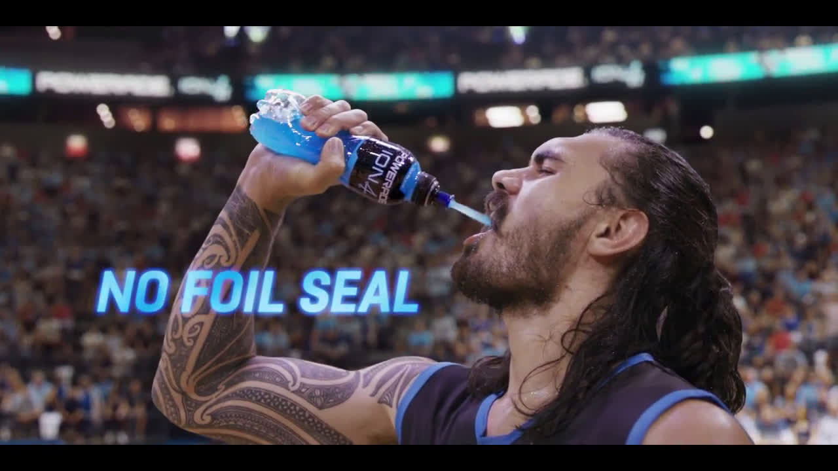


Celebrity Endorsements
All Blacks, Steven Adams, Beyonce, Santa!

Slide 7


Health Claims & Branding

Slide 8

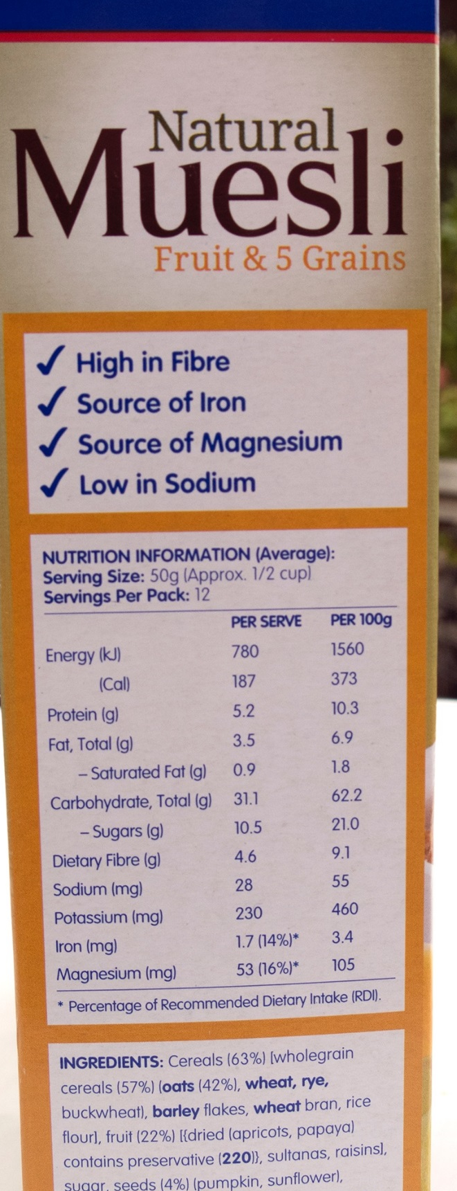
Don’t trust the health claims
Here there are 7 tricks
Most important thing is SUGAR
21% Sugar,
3 tsp per serve

Slide 9




Product Placement
Elf
(2003)
American Idol
The Muppets (2011)

Slide 10
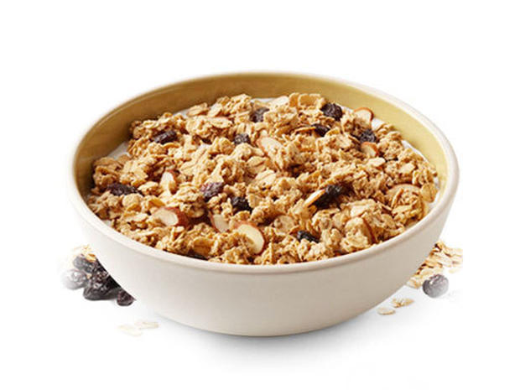
Demo -
What is a typical Serve

Slide 11


Slide 12
RULES: to food choose well?
1. Never TRUST the packaging (industry tricks)
2. Always read the nutrition label – SUGAR content
3. Look for Low or No Sugar options

